Slide 1
COSP230 Ch. 9
Displaying Pictures in a GridView

Slide 2
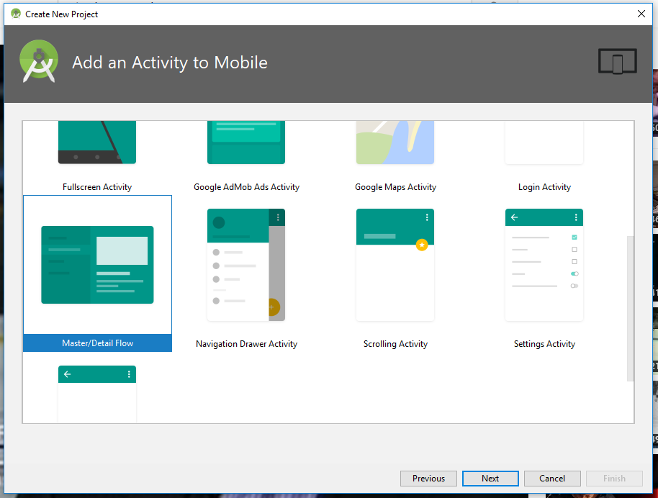
Choose Master/Detail Flow, rather than Empty Project, when adding Activity

Slide 3
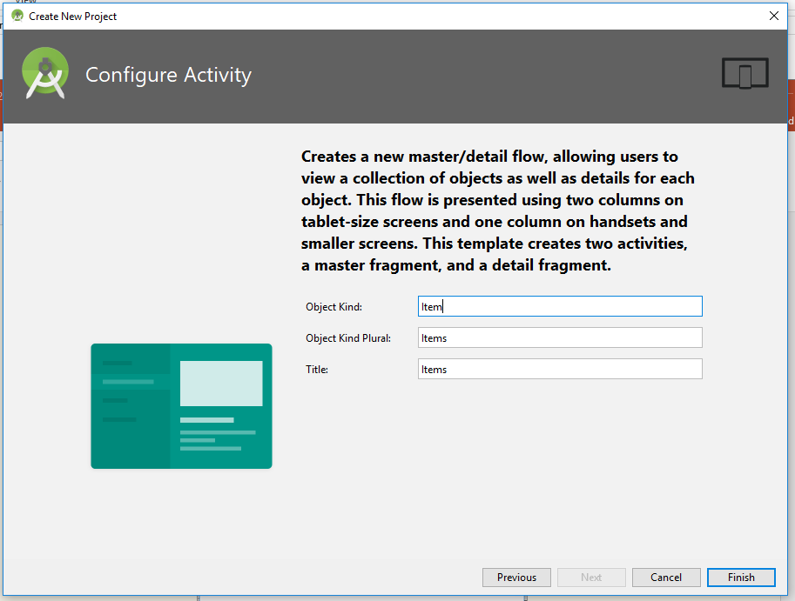
Configure Activity window has default settings. Click Finish.

Slide 4
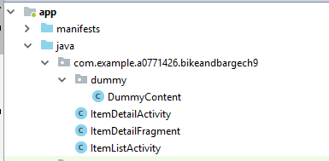
Java Files
ItemDetailActivity
Displays activity_item_detail.xml if smartphone is detected
ItemDetailFragment
Displays item_detail.xml in the detail pane of the app
ItemListActivity
Displays master list in a two pane mode if table is detected or launch a second activity if smaller device detected.
DummyContent
Provide sample code you customize to suit your app
Also displays items in left pane of display for selection

Slide 5
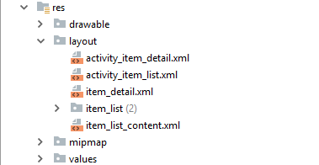
Layouts
activity_item_detail.xml
Displays a FrameLayout instance when a smartphone is detected.
item_detail.xml
Displays detail pane using onCreateView() method on smartphone or tablet.
item_list (2) contains 2 files
item_list.xml displays master list fragment when smartphone is detected
Item_list.xml (w900dp) displays two-pane layout when table is detcted

Slide 6
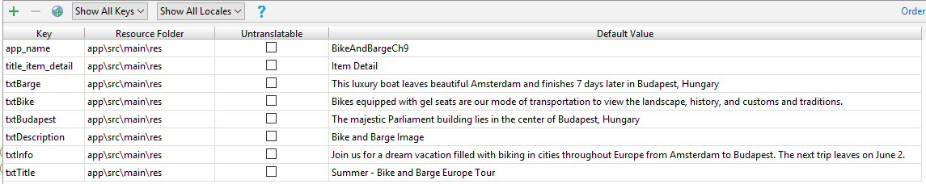
Add keys in Translations Editor
Open the Translations Editor
Add the keys in the table below

Slide 7
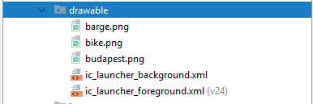
Add sail.png file to drawable folder
Download the barge.png, bike.png, and budapest.png files from Canvas
Copy and paste these file into the drawable folder

Slide 8
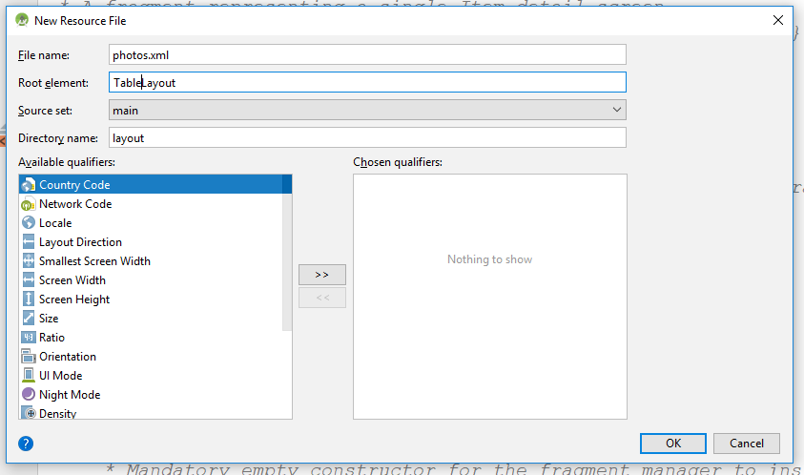
Add a TableLayout named photos.xml
Click File in the menu bar, then click New, then click Layout resource file.
In the dialog box that appears, do the following,
Type photos.xml in the File name text box
Type TableLayout in the Root element text box
Click OK

Slide 9
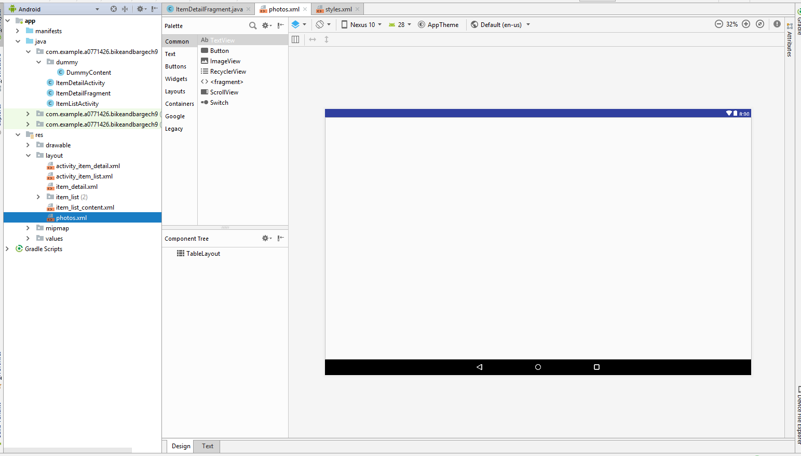
You should get this (select Landscape):

Slide 10
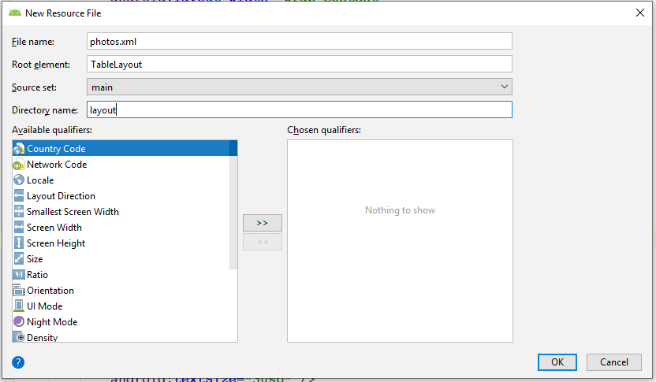
Add a TableLayout named photos.xml
Click File in the menu bar, then click New, then click Layout resource file.
In the dialog box that appears, do the following,
Type photos.xml in the File name text box
Type TableLayout in the Root element text box
Click OK
Be sure this is set to Landscape mode

Slide 11
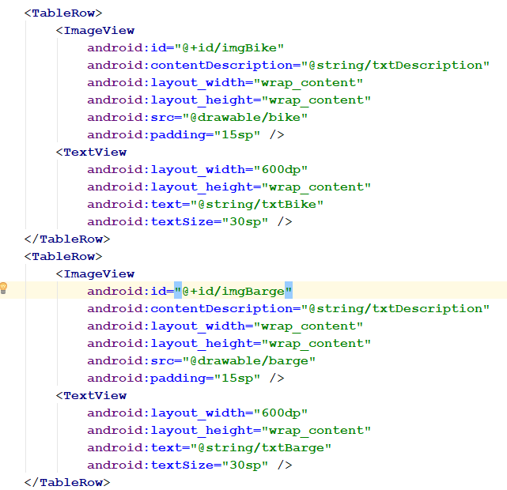
Create controls for first two rows for photos.xml
Click the Text tab for photos.xml
Within the <TableLayout> tags, enter the following XML code (continued on next slide)

Slide 12
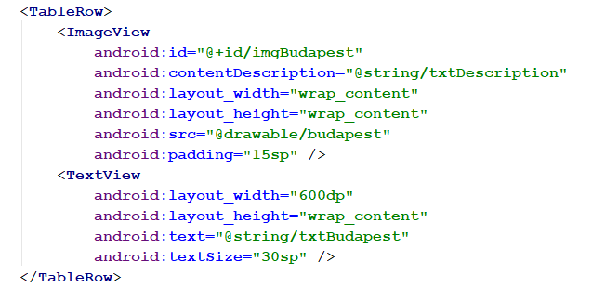
Create controls for last row of photos.xml
Within the <TableLayout> tags and after the code from the previous slide, enter the following XML code.

Slide 13
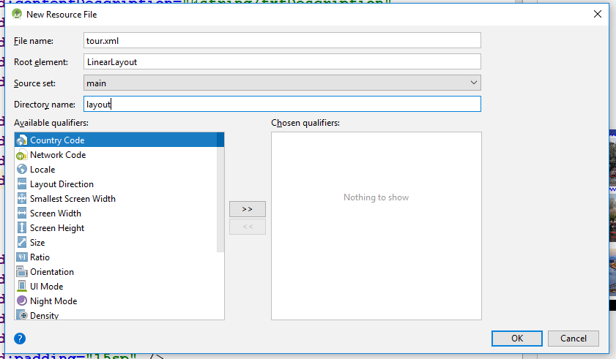
Add a LinearLayout named tours.xml
Click File in the menu bar, then click New, then click Layout resource file.
In the dialog box that appears, do the following,
Type tour.xml in the File name text box
Type LinearLayout in the Root element text box
Click OK
Be sure this is set to Landscape mode

Slide 14
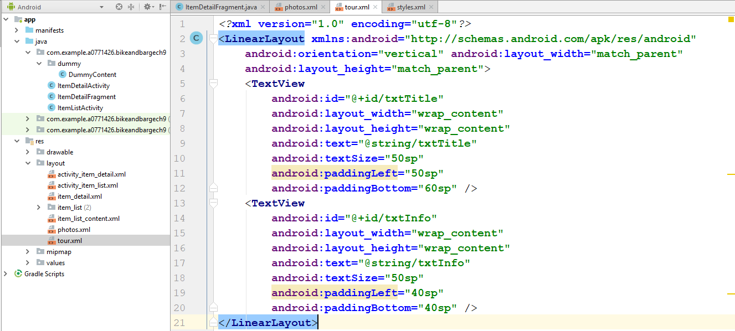
Create TextView controls for tour.xml
Click the Text tab for tour.xml
Within the <LinearLayout> tags, enter the following XML code.

Slide 15
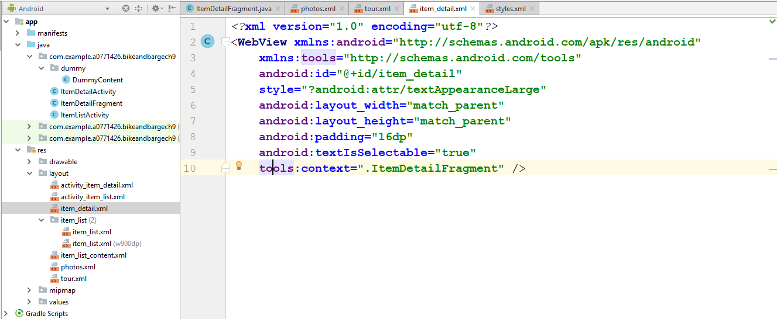
Make item_detail.xml a WebView layout
Double-click item_detail.xml in the Project List
Click the Text tab
In the line after the <?xml> tag, change TextView to WebView.

Slide 16
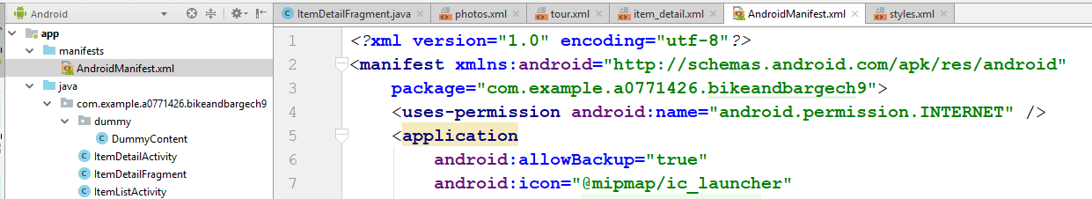
Update permissions in AndroidManifest.xml
Double click AndroidManifest.xml in the Project View
Type the <uses-permission> tag exactly as you see it and where you see it in the box on the right.

Slide 17
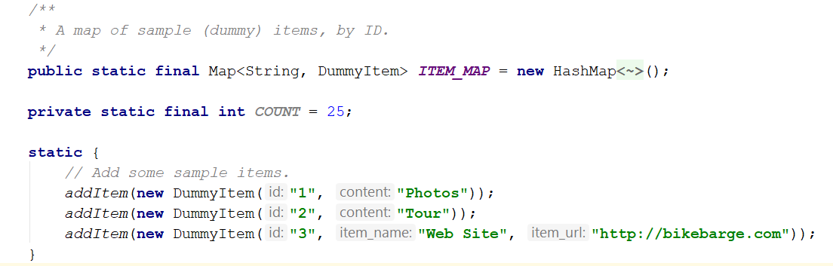
Add code to DummyContent.java
This class provides sample content to display in the user interface of the template.
Make sure the three lines of code after “static” are exactly as they appear in the box on the right.

Slide 18
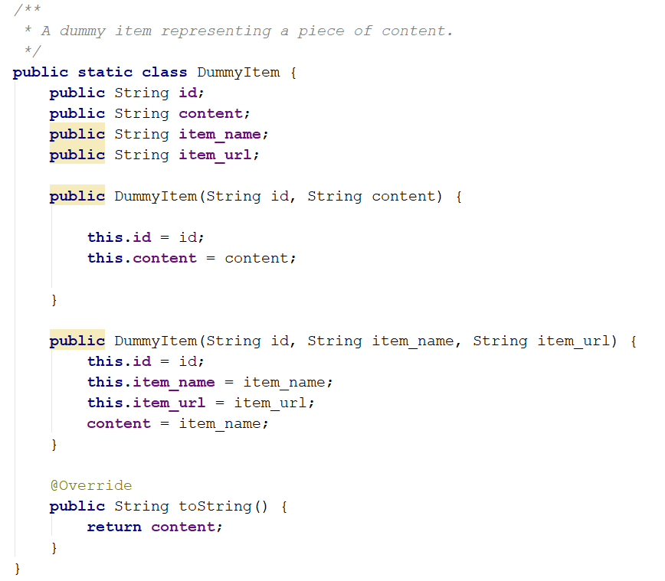
Update code in the DummyItem class
The code for the Web Site in the previous slide (third line you added) should have a red squiggly line under it.
Click on this line and a light bulb should appear.
In the menu for the light bulb, click “Create Constructor”.
The “public DummyItem” method with three parameters should appear.
Add code as needed to make it match the box on the right.

Slide 19
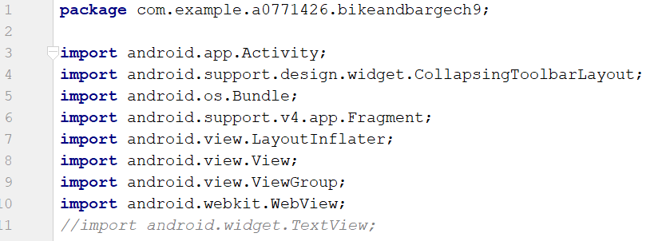
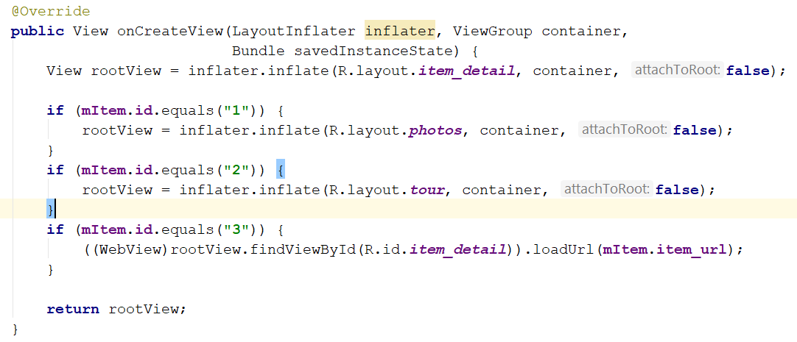
Change code in ItemDetailFragment.java
Open ItemDetailFragment.java
If needed. delete lines which displayed detail list in a TextView.
Delete import of TextView as in top box on the right.
In the onCreateView method, add the code in the bottom box on the right.
equals method – used to see if two strings are the same.

Slide 20
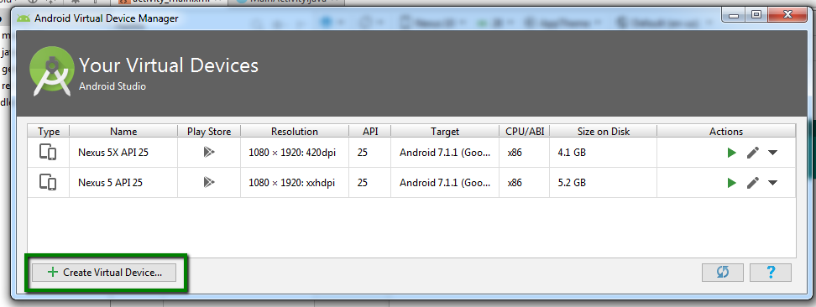
Create New Virtual Device (Nexus 10, unless already created)
In menu bar, select the following:
Tools->AVD Manager
In the window that appears, click the Create Virtual Device… button

Slide 21
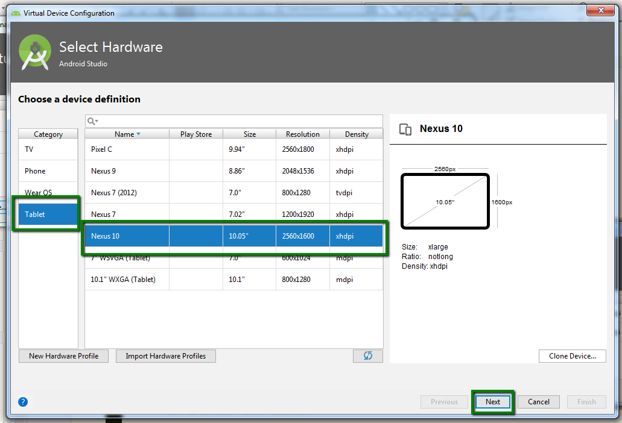
Select a Device Definition (Nexus 10)
Select Tablet in the Category area
Select Nexus 10 from the list of devices
Click Next

Slide 22
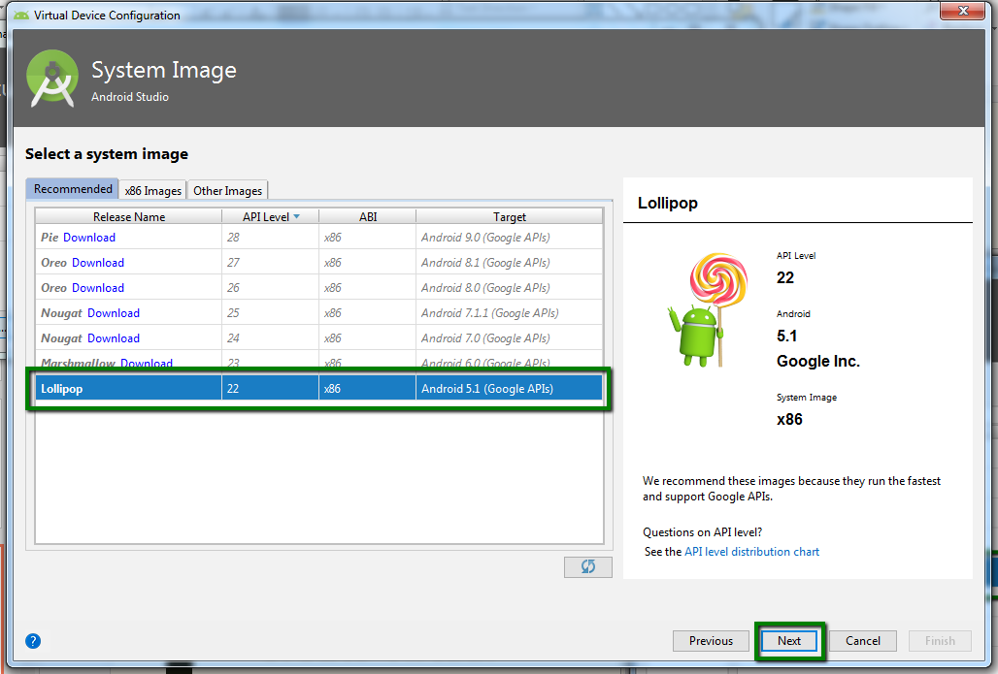
Select System Image (Lollipop)
Click the Recommended tab
Select Lollipop
You may have to download it first
Click Next

Slide 23
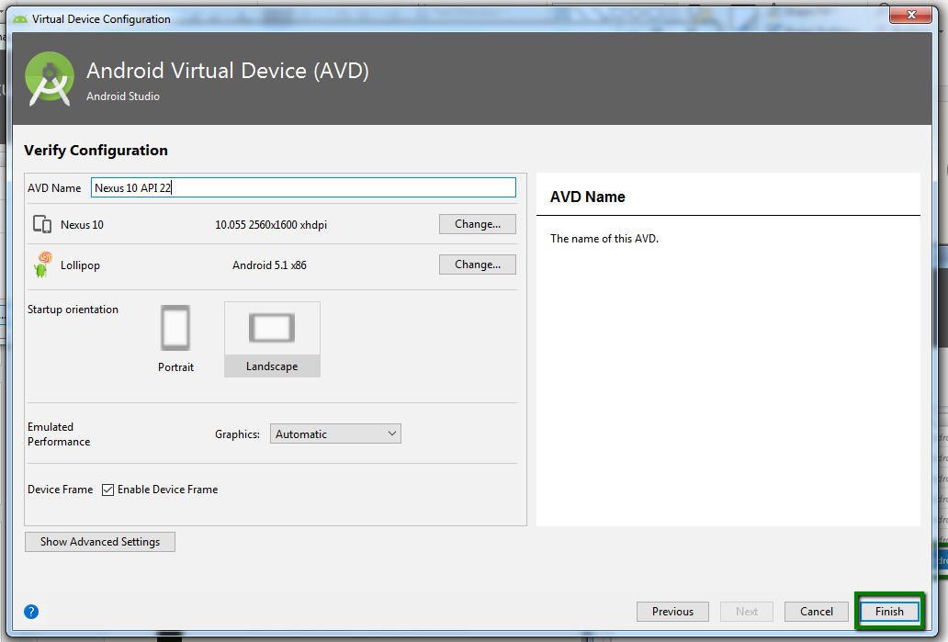
Click Finish to exit the AVD

Slide 24
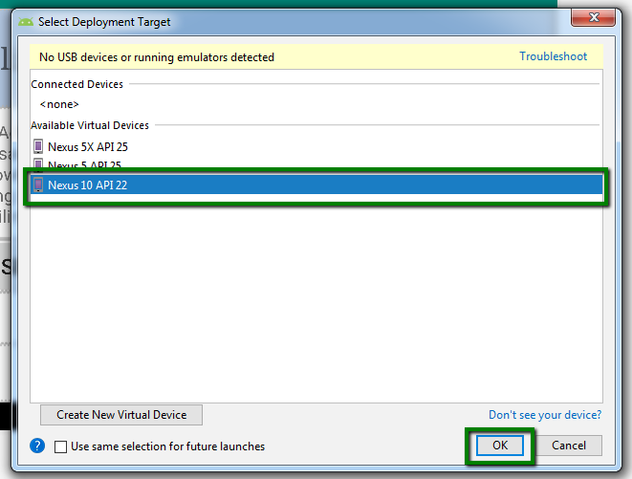
When running, select Nexus 10 API 22

Slide 25
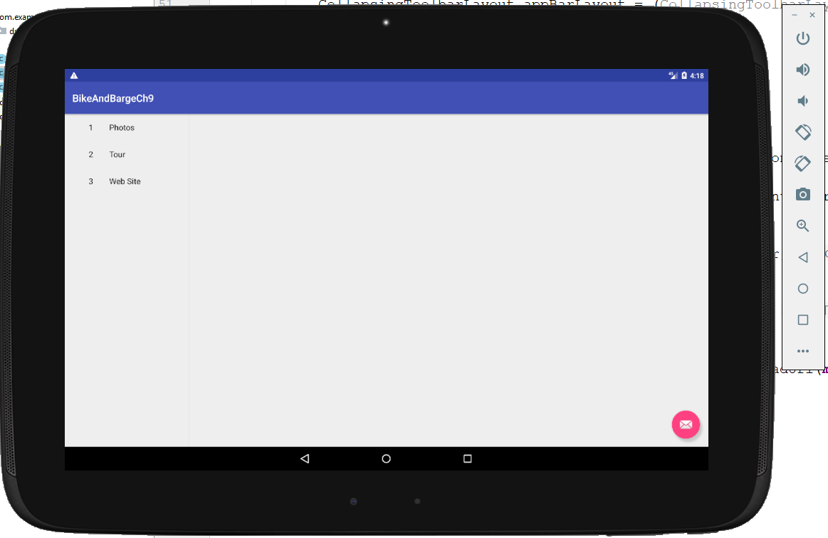
Run the app. You should get this:

Slide 26
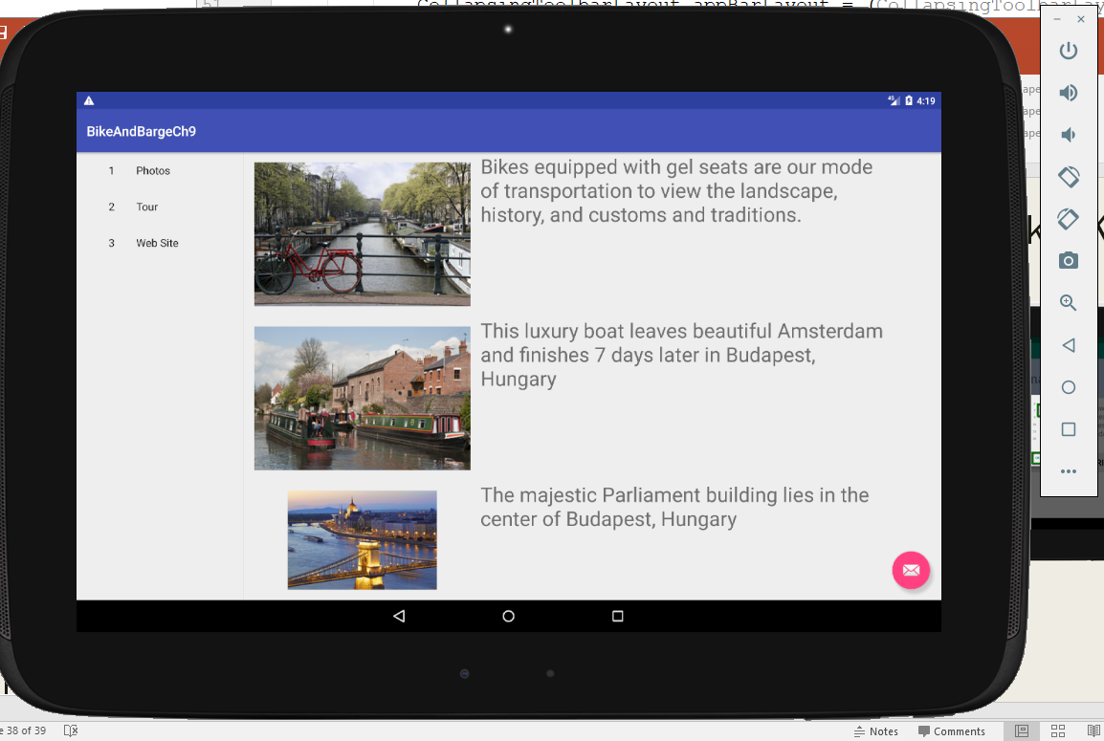
Click Photos for this

Slide 27
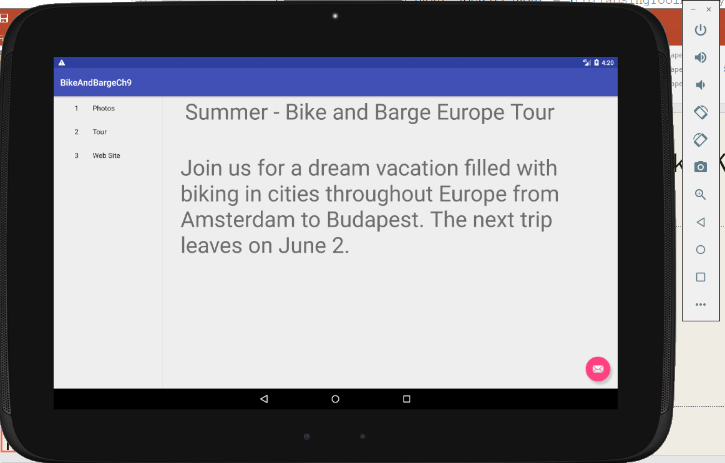
Click Tour for this:

Slide 28
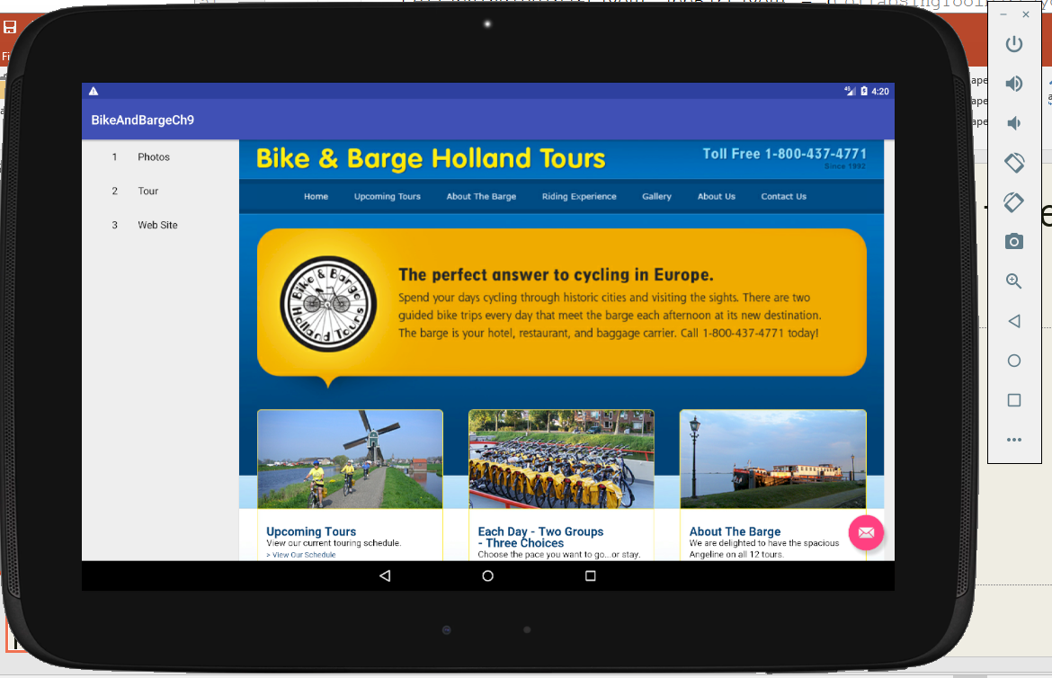
Click Web Site for this:

